Slide 1
Fivetran HVR Training
v1.0
Last updated: 06/05/24
Troubleshooting

Slide 2
Troubleshooting
Errors & Warnings
Understanding Errors
Dissecting some example errors
Latency issues
Latency and contributing factors
Solutions to Capture Latency
Solutions to Integrate Latency
Time Profiler
Data discrepancies
Reasons
Best Practices
Accessing Fivetran Support Resources
Reporting Issues to Support
This module provides the overview of the concept of error logging and handling in HVR. It also touches on the subject of latency, and various best practices for resolving latency issues. We also touch on the most common causes of data discrepancies, and ways to resolve them.

Slide 3
Errors & Warnings

Slide 4
Warnings
Warning codes start with W_J.
Show up in the log viewer as orange text.
Non-disruptive.
Typically shown as sign of a minor problem, or notification.

Slide 5
Errors
Error codes start with F_J.
Show up in the log viewer as red text.
Fail or retry the Job.
Major events where the continuation of a job is not possible.

Slide 6
Examples
Warnings
Coercion conversion
Reaching memory usage limits / spilling to disk
Resilient conversion
License expiration warnings
Encountering DDL changes
Not seeing the beginning of a long-running TX
Errors
Inability to connect to an endpoint
Network Issue
Failed SQL execution
Failed file write
Missing Libraries (e.g. ODBC-driver)
Running out of storage space

Slide 7
True or False? HVR can continue processing after encountering an error.
False.
The Job will be restarted.

Slide 8
True or False? Warnings stop the Job until a user acknowledges the problem.
False.
Warnings are simply logged, and the Job continues normally.

Slide 9
Understanding Errors

Slide 10
Understanding Errors
Error messages tend to be verbose for a reason.
They contain:
Date/time of the entry and job name
HVR internal error codes that may help triaging the problem
A long description of the problem including what HVR did to try and solve it
A database error code if applicable
Ways to fix the issue manually
Ways to report the issue to Technical Support
2024-02-20T13:04:01+01:00: testchn-cap-testloc: F_JT0905: Log start positioning error F_JZ1100. Capture job unable to locate file sequence 164020 for resetlogs_id 1139073335 in thread 1 which corresponds to hvrinit time 2024-02-17 00:22:02. It first checked primary archive directory '/oracle/PUW/oraarch_1' for files matching pattern 'PUWarch%t_%s_%r.dbf', but although 113 files matched, none were for sequence 164020. Perhaps these archive log files have been purged by RMAN. The capture job requires that these files are restored (e.g. from tape); otherwise a new hvractivate is required (use option -i to rewind to specific capture time). In future this problem can be avoided by reconfiguring RMAN to keep these files for longer.

Slide 11
Dissecting the Error
Basic information | 2024-02-20T13:04:01+01:00: testchn-cap-testloc:
Error code and statement | F_JT0905: Log start positioning error F_JZ1100. Capture job unable to locate file sequence 164020 for resetlogs_id 1139073335 in thread 1 which corresponds to hvrinit time 2024-02-17 00:22:02. |  |  |  |  | HVR did not find the log file that it was supposed to read next. Error codes start with the F_ prefix.
What steps preceded the error? | It first checked primary archive directory '/oracle/PUW/oraarch_1' for files matching pattern 'PUWarch%t_%s_%r.dbf', but although 113 files matched, none were for sequence 164020. |  |  |  |  | HVR checked the log file in the archive location, where it should be present.
What may be the problem? How can it be solved? | Perhaps these archive log files have been purged by RMAN. The capture job requires that these files are restored (e.g. from tape); otherwise a new hvractivate is required (use option -i to rewind to specific capture time). In future this problem can be avoided by reconfiguring RMAN to keep these files for longer. |  |  |  |  | Oracle’s log manager may be misconfigured and removes logs while HVR is reading them. You either restore the missing logs, or reset capture time.
Technical Support How-To | [Not applicable to this specific Error Message] |  |  |  |  | If there are specific steps to report this error to Technical Support, they would be displayed here.

Slide 12
Example 2
This is a simple error message.
The host specified as integrate Agent is unreachable.
This can be either due to a network / firewall issue, or due to the Agent Listener not running.
2024-03-18T11:20:39+00:00: test-integ-t_pdd: F_JG2111: Connect to host 'dev-hvredge.cloud.fivetran.com' and port 4343 for coprocess 'ch_t_pdd' failed. Error: Connection timed out.

Slide 13
Example 3
This is an example for a very detailed error message.
2024-03-06T11:28:39+01:00: puw_p_t_1-cap-sap_puw: F_JT0471: Pipe TxGroup encountered a change for table 'zeidet_lar_msg_c' column 'freitext' with an incomplete column value. If this is related to a partial LOB operation define Capture AugmentIncomplete=LOB. This scanner started reading at timestamp 2024-03-06T11:22:37+01:00 and SCN:subseq 00000000485429508203:00003. The commit was at SCN:subseq 00000000485429529279:00001 with timestamp 2024-03-06T11:22:53+01:00. To report this to Technical Support, first re-run the job as follows; "hvr -EZIZ_FILE_TRACE=1 -EHVR_EXPORT=ZIZ_FILE_TRACE $HVR_CONFIG/hubs/<hub>/channels/<chn>/jobgen/<chn>-cap-<loc> >f.out 2>&1" Check that the error in the file is still the same, and then send the following; (1) File f.out. (2) Enroll files matching *.enroll or *.enroll_rev_* in $HVR_CONFIG/hubs/<hub>/channels/<chn>/locs/<loc>/enroll (3) Cap_state files matching *.cap_state in $HVR_CONFIG/router/<hub>/<chn>/loc_<loc> (4) All files mentioned in ZIZ_FILE_TRACE messages in file 'f.out'. After saving these files, re-run the capture job to check the error and files mentioned in ZIZ_FILE_TRACE messages stay the same. To skip this transaction's changes to this table, use command { hvrcontrol -c -lsap_puw -s -tzeidet_lar_msg_c -whvr_tx_id=0x10a001c00000000 -x0 hvrhub puw_p_t_1 }. If this fails, skip all log records for this timestamp with command; { hvrcontrol -c -lsap_puw -s "-whvr_rec_tstamp=2024-03-06T11:22:53+01:00" -x0 hvrhub puw_p_t_1 }. Afterwards, restart the capture job. The skipped change(s) can be recovered later with on-line refresh; { hvrrefresh -rsap_puw -tzeidet_lar_msg_c -qwo hvrhub puw_p_t_1 }.

Slide 14
Dissecting the Error
Basic information | 2024-03-06T11:28:39+01:00: puw_p_t_1-cap-sap_puw
Error code and statement | F_JT0471: Pipe TxGroup encountered a change for table 'zeidet_lar_msg_c' column 'freitext' with an incomplete column value. |  |  |  |  | HVR found an incomplete element in the database log while it was extracting data from it.
What steps preceded the error? | This scanner started reading at timestamp 2024-03-06T11:22:37+01:00 and SCN:subseq 00000000485429508203:00003. The commit was at SCN:subseq 00000000485429529279:00001 with timestamp 2024-03-06T11:22:53+01:00. |  |  |  |  | Information about where HVR was in the log sequence when it encountered the error.
What may be the problem? How can it be solved? | If this is related to a partial LOB operation define Capture AugmentIncomplete=LOB. |  |  |  |  | HVR actually tells you how to solve the problem here. Column freitext is a CLOB in Oracle, and requires AugmentIncomplete=LOB defined on the capture action.
Technical Support How-To | To report this to Technical Support, first re-run the job as follows… |  |  |  |  | The rest of the error message is information on how to report this to Technical Support.

Slide 15
True or False? An HVR error message is built up of multiple parts.
True.

Slide 16
True or False? HVR never supplies information on how to resolve an error.
False.

Slide 17
Latency Issues

Slide 18
Latency
SQL Statement execution.
A new change is generated on the source system.
t-5s
t-4s
Record committed and written to transaction log.
It takes time for a database to write a change to the log.
Latency is the time difference between the state of data in a source DB and the replicated dataset.
Latency is a natural byproduct of asynchronous log-based replication.
You may experience higher latency in events of high transaction traffic. Lower latency usually bears a higher cost on the target, since you have to integrate more frequently.
capture latency
t-3s
Record is read by HVR.
integrate latency
t-2s
Record is transmitted to the Hub and stored in a .tx file.
t-1s
Integrate picks up the .tx file.
The transaction file is processed as part of the Integrate Cycle.
t
Record is integrated by the target DBMS and committed.
The new data has landed in the target. The target database has processed the SQL statements.

Slide 19




Contributors to replication latency
Source
Target
Network
Capture Method
TX Volume
Disk IOPS
Lack of HVR Agent
LOB datatypes
Capture Expressions
ALO - Freq of Log Switches
Integrate Machine HW Spec
DBMS Disk Write Speed
Integration Method & TX Vol
Integrate Expressions
Resilient processing
Lack of Primary Keys
DBMS Index Optimization
Network Latency
Network Bandwidth
Connection Reliability
Lack of HVR Agent
Notes:
Talk about only the contributors and not the solutions.

Slide 20






Solutions to Capture Latency
Pick the right Capture Type
Use Agents
Channel Design
Prefer DIRECT over SQL capture. Accessing logs in Oracle ASM is slower than DIRECT capture from files (API limit).
Prefer installing Agents wherever possible. HVR uses a custom protocol over TCP/IP, and compression while moving data.
Find the balance between the number of tables in a channel, and the number of channels.
Review Network
Omit LOB capture if possible
Capture Expressions
Review your network infrastructure. Try to be physically close to the source machines with the HVR Hub.
Do not capture LOB values if there is no business need. AugmentIncomplete can be disabled.
Validating CaptureExpressions or Conditions means that Capture must perform additional work with each row.

Slide 21


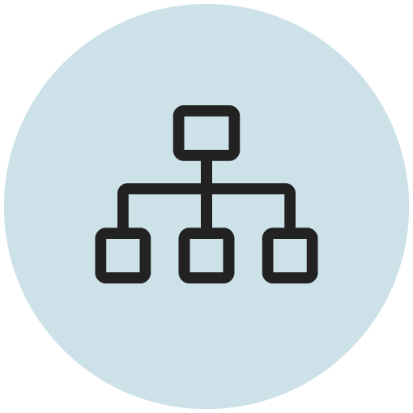




Solutions to Integrate Latency
Rightsized Hardware
Use Optimization Strategies
Channel Design
Pick the right compute size for the volume of data you wish to CDC. HVR relies on the target database to run the submitted SQL.
Use available optimization strategies in your target database. Use clustering, indexing, distribution keys, partitioning.
Design channels with Integrate parallelism. Skip replicating unnecessary columns.
Stable Network
Identify high-TX tables
Integrate Expressions
Integrate Jobs may run up to hours, and it is vital to have a stable connection.
In some cases, a single table may contribute to half of the TX volume. Separate these to achieve better latency.
Validating IntegrateExpressions means that Integrate may perform additional work with each row.

Slide 22

Time Profiler
What?
Measures time spent during execution of a job across different subtasks and divides it into predefined categories like SQL or Network I/O. This is called Time Breakdown.
Time Profiler is great if you want to understand how much time a Job spends with various subtasks.
Why?
In some edge cases, Jobs need microscopic analysis to find the best possible performance configuration.
How?
Enable by setting the Environment variable HVR_TIME_PROFILER_TRACE to LOW (or higher). Then get additional log lines after each cycle.

Slide 23
Time Profiler Task Categories
Category | Details
SQL | Time spent while executing SQL queries.
FProc | Time spent while executing FProcs. An FProc is an internal HVR function.
FPipe | Time spent while executing FPipes. An FPipe is a pipeline for high speed data flow.
Disk-IO-temp | Time spent while reading/writing temporary files in $HVR_TMP folder.
Disk-IO-location | Time spent while reading/writing files from outside of HVR folders.
Disk-IO-config | Time spent while reading/writing files in $HVR_HOME and $HVR_CONFIG folders.
Network-IO | Time spent while sending, receiving data or waiting for the network in HVR protocol.
Log-scan | Time spent while scanning redo log files.
Idle | Time spent while waiting idle.

Slide 24
True or False? Latency always shows that there is a problem with the HVR configuration.
False.

Slide 25
True or False? Capture latency may be solved by switching to a faster log read method.
True.

Slide 26
True or False? Integrate job latency is mainly driven by HVR’s own performance
False.
It is mostly driven by the performance of the target DBMS.

Slide 27
Data Discrepancies

Slide 28
Reasons
Latency
Latency causes an almost ever-present data difference between source and target tables. Your missing data may be in-flight!
Datatypes
Some datatypes cannot properly be represented in another DBMS. This is not a limitation of HVR.
Issues during Operation
Activating with Capture Time Reset may cause an unnoticed data gap. Similarly, Restrict Actions without a Context can lead to improperly loaded data.
Untreated Resilience
Paying attention to Resilient Warnings in the HVR log is important. These can be clear signs of mismatched data.

Slide 29
Best Practices
Data Validation
Either perform Online Compare of tables (if size permits), or set up Compare on data subsets. Set up a difference threshold.
Communication
Make sure to have good communication channels with the team supporting your sources and targets. Align on events, outages.
Alerting & Monitoring
Make sure to set up monitoring on your log, by either sending alerts or building a custom solution that checks for Errors or Warnings in the log.
Documentation
Create documentation for environment specific problems, including escalation paths and responsibilities for different stakeholders

Slide 30
Accessing Fivetran Resources

Slide 31
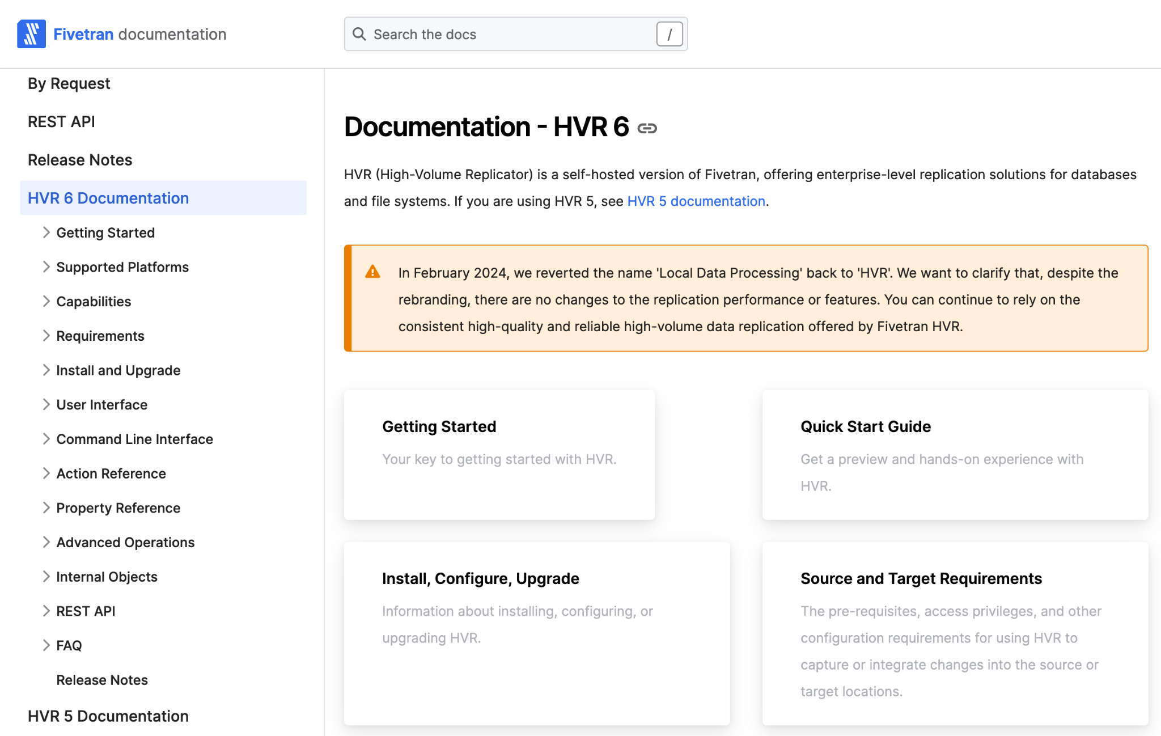

Read the Manual
Fivetran HVR has a comprehensive manual with information on all aspects of the product.
https://fivetran.com/docs/hvr6

Slide 32
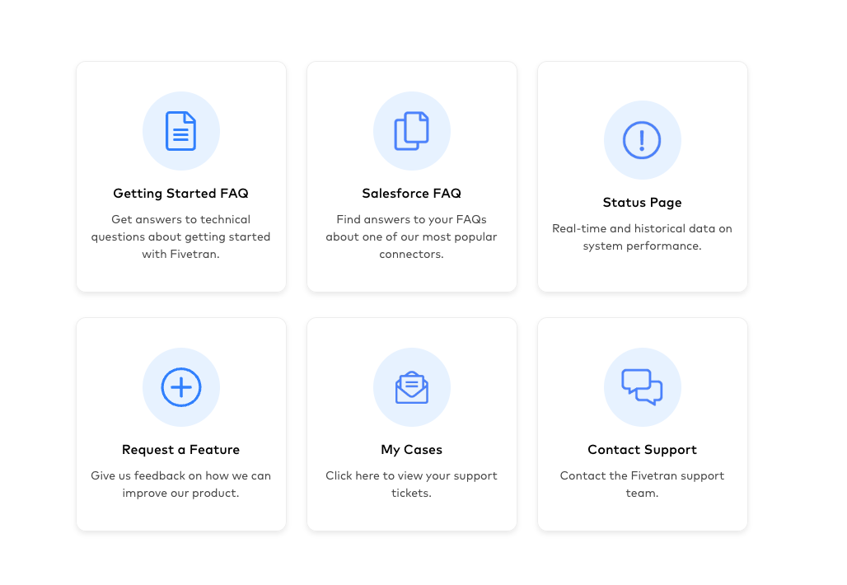
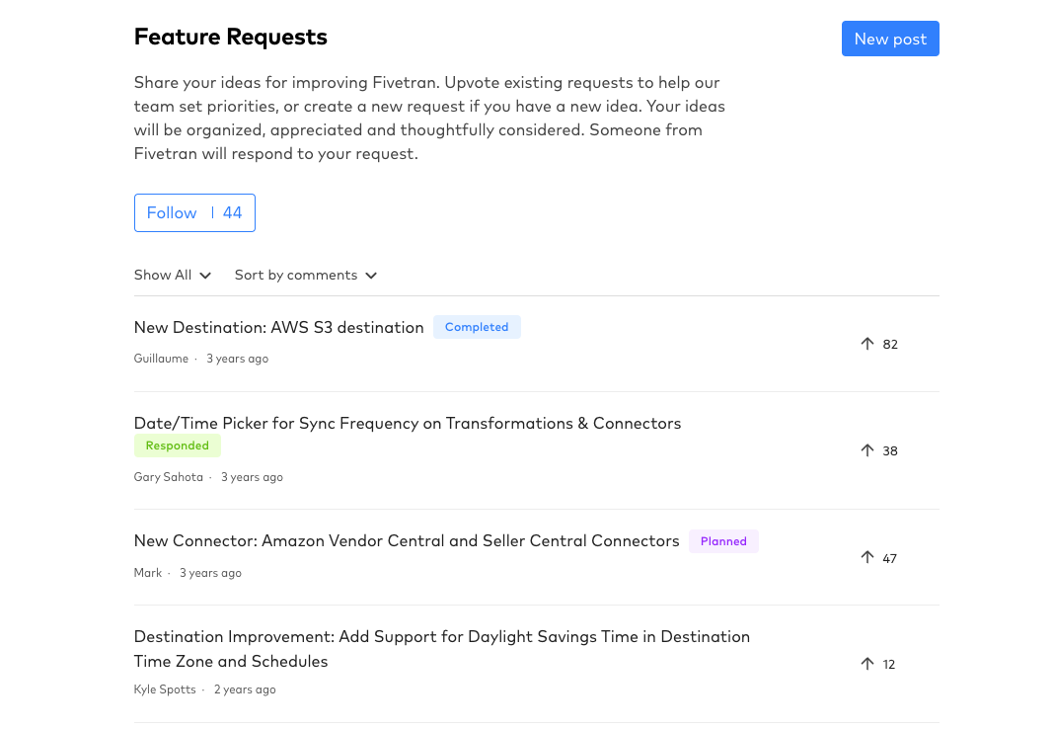
Share Your Ideas
Upvote existing feature requests to help our team set priorities, or create a new request if you have a new idea.
https://support.fivetran.com/hc/en-us/community/topics/360001909373-Feature-Requests

Slide 33
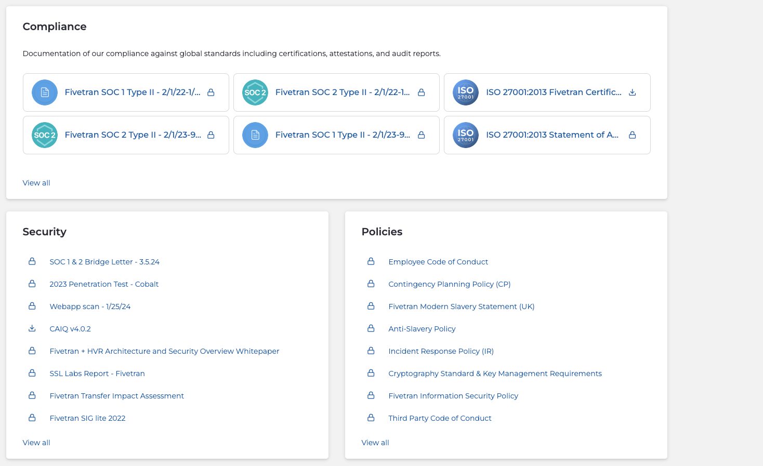
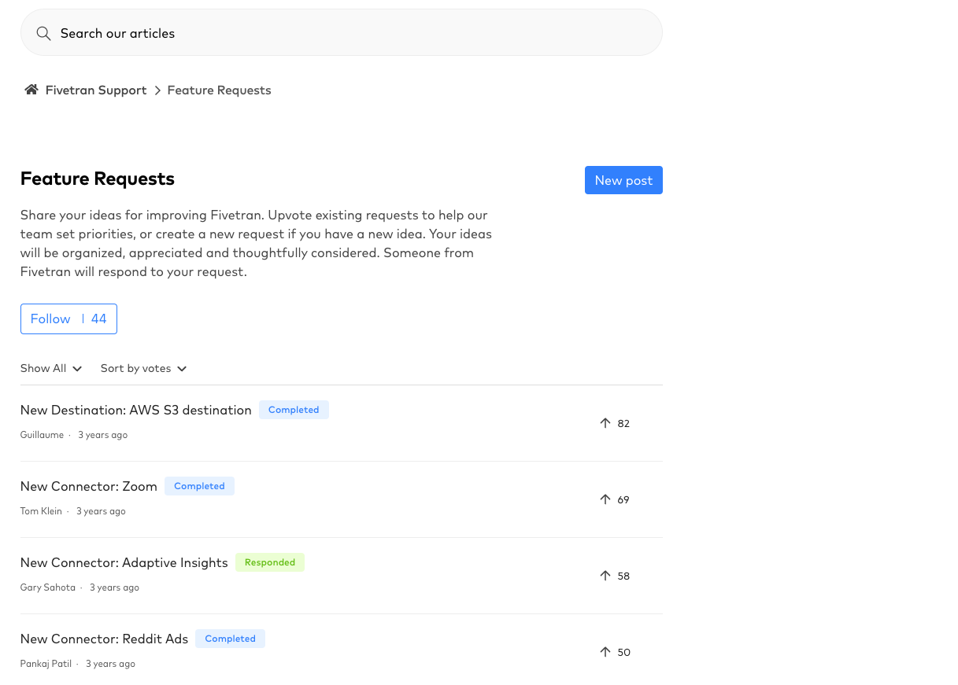
Compliance
Within our Trust Center, you can learn about Fivetran's approach to earning customer trust and securing customer data.
https://trust.fivetran.com/

Slide 34
How can we help?
Use the Support Portal to contact our support team.
https://support.fivetran.com/

Slide 35
Reporting issues to Support
What to share for better assistance?
Log File / Error Message
Versions
Capture State File
This may be evident, but provide context of your problem. The easiest way is to provide logs as evidence.
All versions are important be it HVR, source DB, target DB.
The capture state file stores your job’s last known position in the redo log stream.
Enrollment file
Transaction files (Router dir)
Channel Export / Hub Snapshot
Contains collected metadata from the source about the tables you replicate, such as table IDs.
In-flight transactions captured from the source but not yet integrated to the target.
The complete configuration of your replication, including HVR’s version of the tables you replicate.

Slide 36
Key Learnings
1
Explored HVR’s error and warning system.
Learned about replication latency.
Learned about troubleshooting capture and integrate latency issues.
Learn about data discrepancies and some tactics on how to avoid them.
Learned how to leverage available Fivetran resources. Learned how to report issues on the Support portal.
2
3
4
5
6

Slide 37
Q&A

